Slide 1
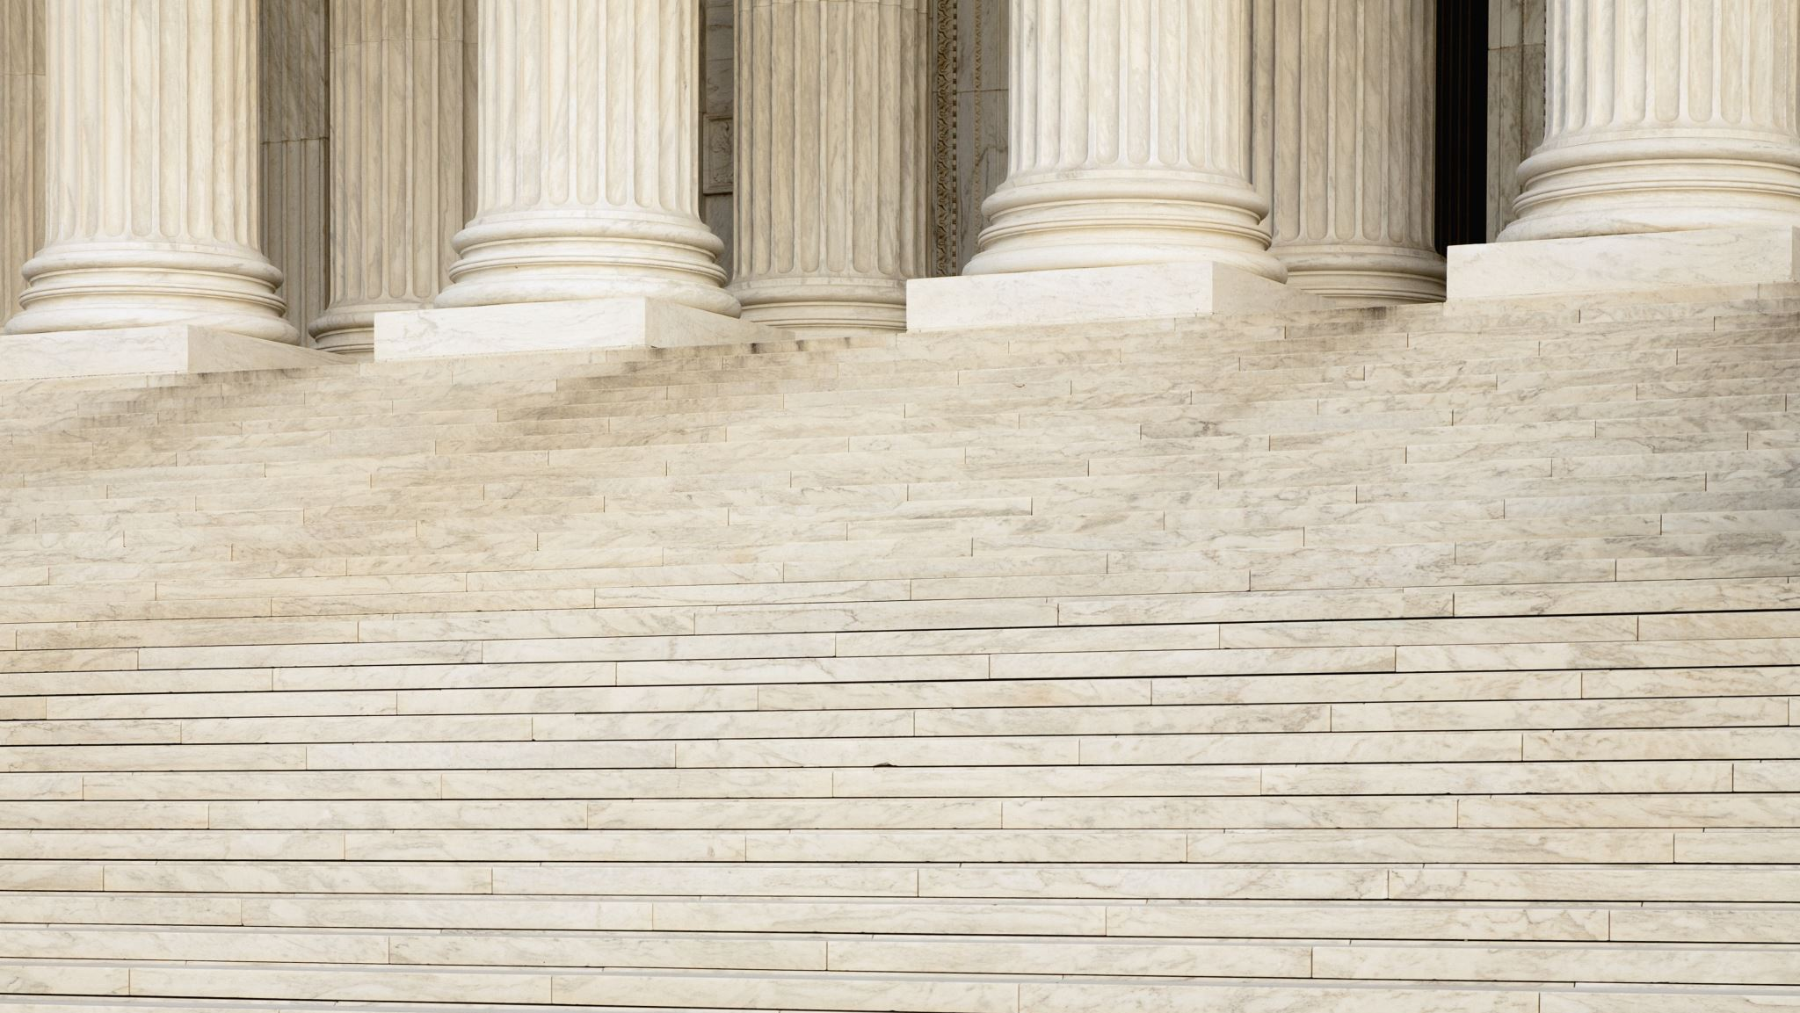
The Saint Philip Neri Awards Program Overview
Review of the Purpose, History, and Nominations

Slide 2
Purpose
The Saint Philip Neri Awards Program was established by the United States Army Special Forces Command in 2002 to recognize former and current Special Forces soldiers who embody the highest standards of an ideal Special Forces Soldier and have made significant contributions to the United States Army Special Forces Regiment or the Special Forces Association.

Slide 3
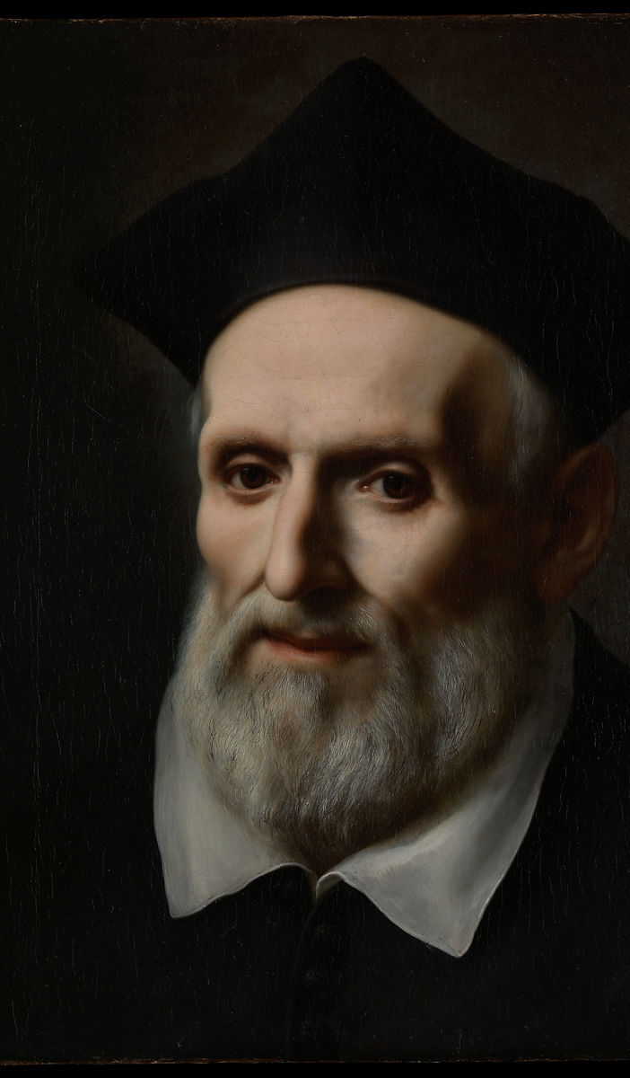
So, why Saint Philip Neri?
Saint Philip Neri was a respected and accomplished 16th Century Italian Priest.
He was selected as the Patron Saint of Special Forces because he embodied many traits of the ideal Special Forces Soldier, selfless, superb teacher, and inspirational leader.
This Photo by Unknown Author is licensed under CC BY-SA

Slide 4
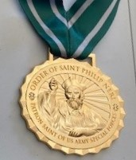
The History
The Order of the St. Philip Neri is a three-level award, Gold, Silver and Bronze, awarded to Association members, Active Duty and National Guard Special Forces qualified soldiers.
The Medal was first awarded at the SFA 50th Anniversary Banquet with three Gold Medal Awards.
On 26 May 2003, General Lambert, CG USASFC, officially turned over the program to the SFA for administration and implementation.
Since that time, the SFA has awarded 321 medals
34 - Gold
27 – Silver
260 - Bronze

Slide 5
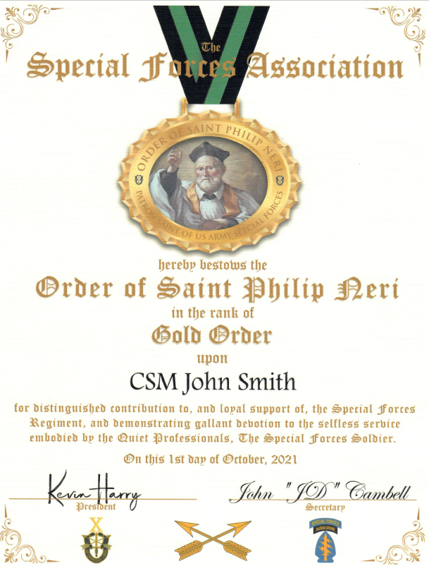
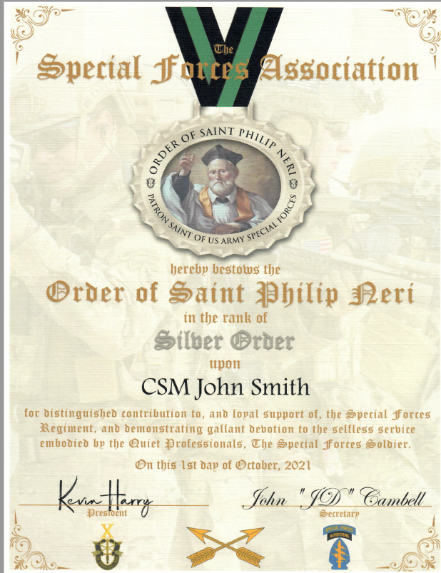
Modernized Certificates

Slide 6
Nominations
All nominations for medals must include a nomination letter, photograph of the nominated individual and a biography. The nominations may be mailed to the SFA Headquarters or uploaded through the SFA website. https://www.specialforcesassociation.org/saint-philip-neri-award/
Any member of the Special Forces Association may nominate another Association member for the Gold or Silver Order Award. The Bronze Order Medal is reserved for Active Duty and National Guard Special Forces qualified soldiers only who have contributed in a significant way to the improvement of the United States Army Special Forces.
Any Nomination for someone other than an Association member must be approved by the National Board of Officers for submission to the Selection Committee for their consideration.
Nominations may be submitted during the months of November, December, January, and February each year with a cut-off date of the last day in February to be considered by the Selection Committee.

Slide 7
Questions

